Slide 1
Securing caCORE SDK Generated Applications
caBIG Developer Boot Camp
Satish Patel/Vijay Parmar

Slide 2
Session Goals
By the end of this session, you will be able to:
Secure the the caCORE Software Development Kit (SDK) generated applications

Slide 3
Agenda
Security in SDK generated application
Using CSM’s User Provisioning Tool for SDK
Configuring SDK code generator
Running secured system

Slide 4
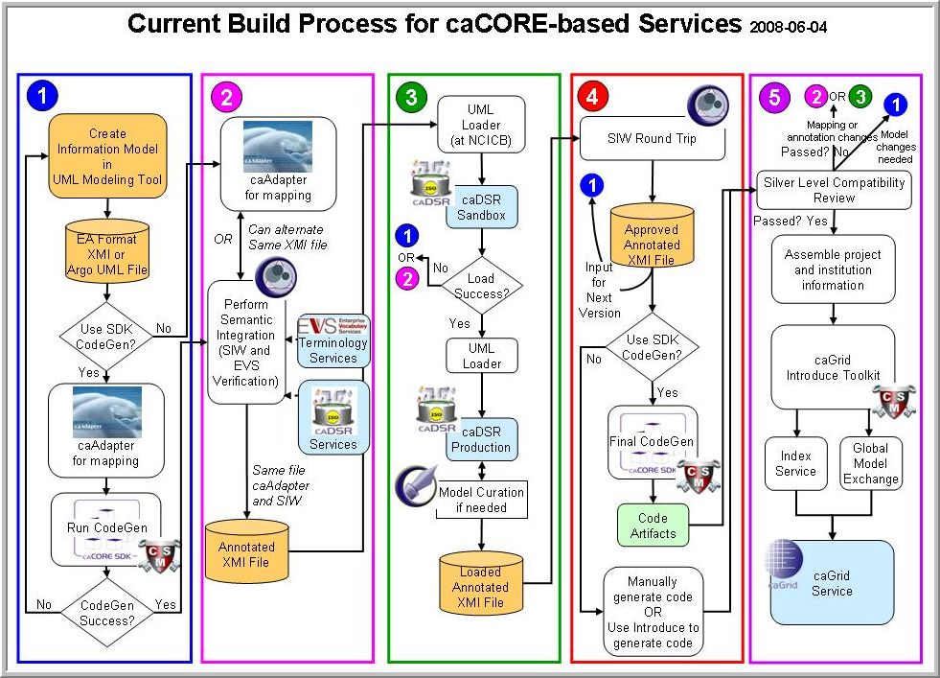
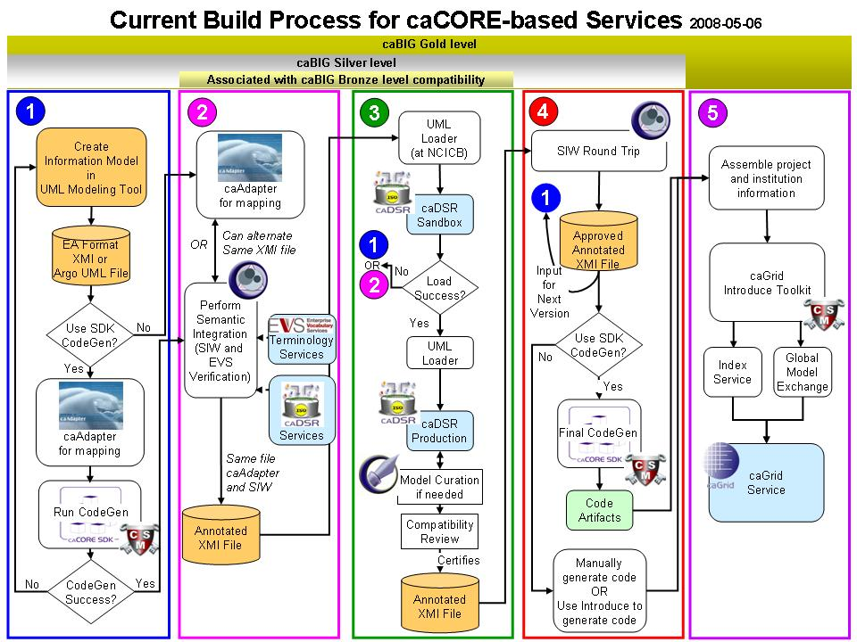
Metadata Reuse
Create UML Model
Semantic Annotation
Transform UML Model into Metadata
SDK Code Generation
Compatibility Review
Create a Node on the Grid

Slide 5
What is Required to Use Security in SDK Generated Application
Must have working knowledge of
  Common Security Module (CSM)
  User Provisioning Tool (UPT)
Nice to have knowledge about
  Security Concepts
  JAAS
  XML
  LDAP

Slide 6
Required Software
Everything needed for caCORE SDK
Installed User Provisioning Tool (UPT)

Slide 7
Security Basics
Authentication
  Who is trying to access the system
Authorization
  Can the user access the resource

Slide 8
Security in caCORE SDK
Class level security
  E.g. Only investigators can look at data in Patient class
Instance level security
  E.g. Investigators can look at only their patient’s data
Attribute level security
  E.g. Nurses can not see patient’s social security number

Slide 9
Security Configuration
Configure Application Server
Configure security policy using User Provisioning Tool
Configure caCORE SDK

Slide 10
SECURING SDK GENERATED SYSTEM
STEP 1:
CONFIGURING
APPLICATION SERVER

Slide 11
JAAS Login Module Configuration
Jboss
  Configure login-config.xml under jboss/server/default/conf folder
  Make an entry for a new login module
  Name of the module should be same as CSM_APPLICATION_NAME used in the deploy.properties
Tomcat
  Create login.config file
  Make an entry for a new login module
  Name of the module should be same as CSM_APPLICATION_NAME used in the deploy.properties
  Start Tomcat with the follwing property
  java.security.auth.login.config=c:/myconfdir/login.config

Slide 12
SECURING SDK GENERATED SYSTEM
STEP 2:
CONFIGURING UPT

Slide 13
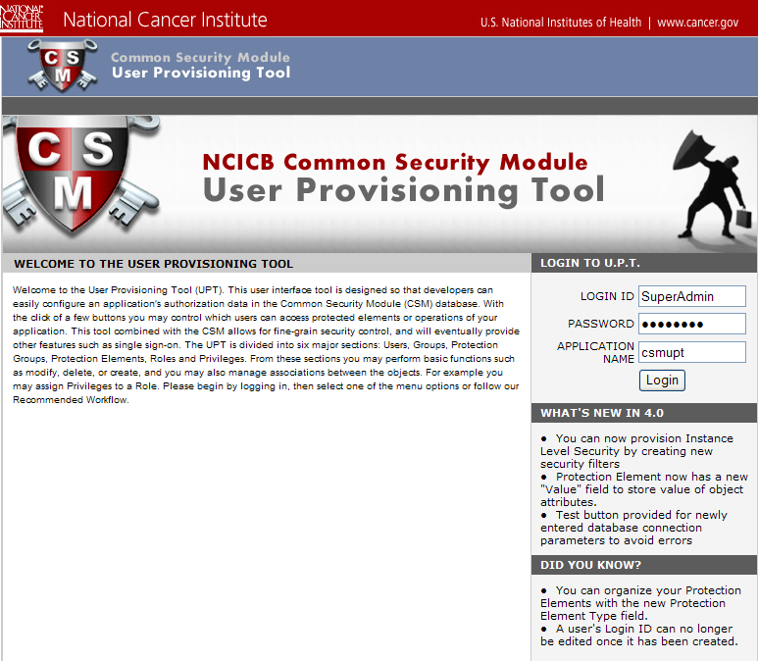
Log Into UPT

Slide 14
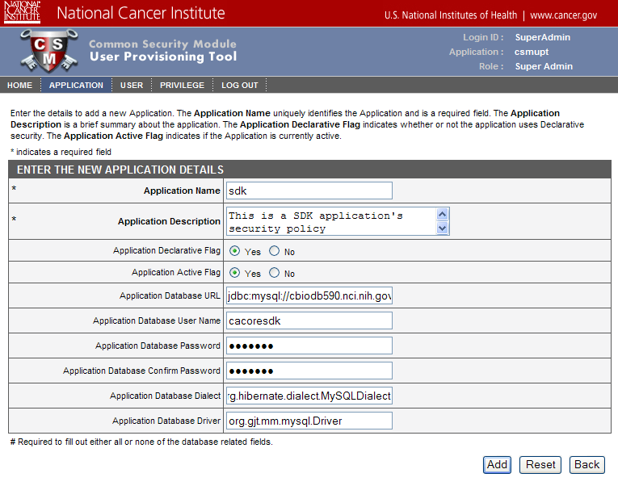
Create a New Application

Slide 15
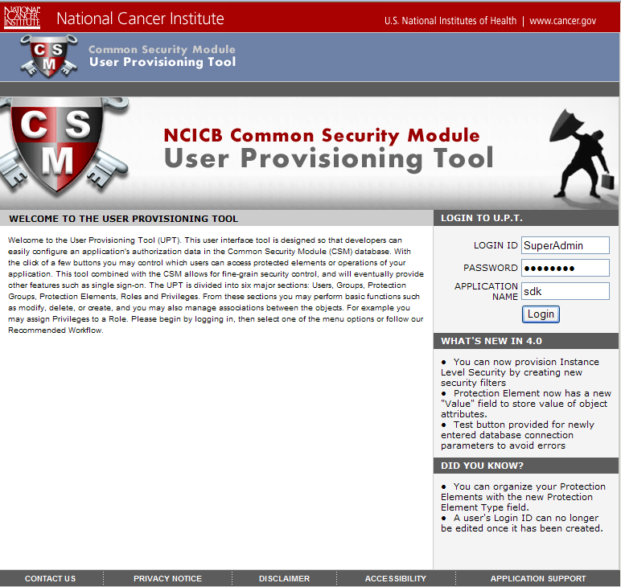
Log Into Application

Slide 16
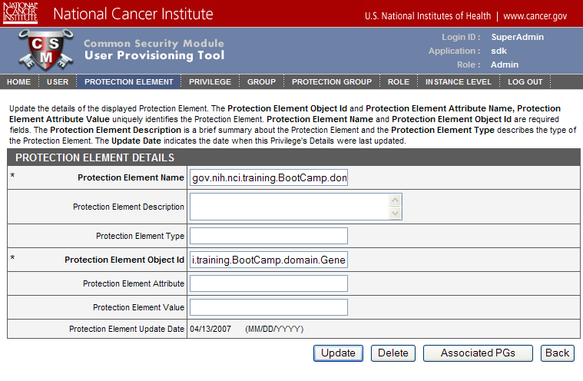
Create a Protection Elements for
Class Level Security

Slide 17
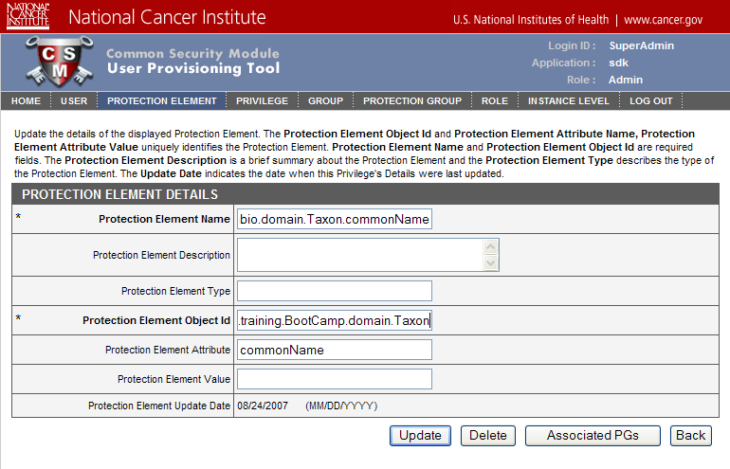
Create a Protection Elements for
Attribute Level Security

Slide 18
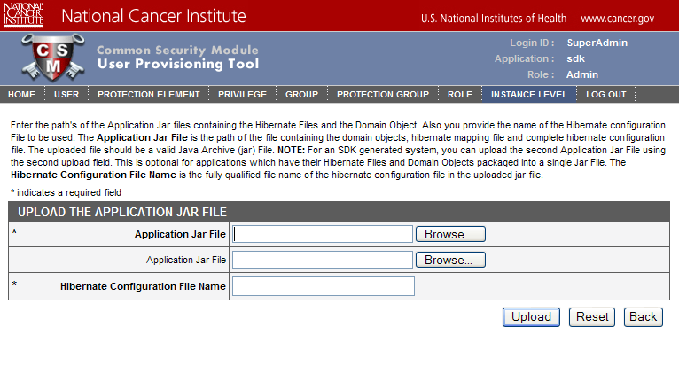
Creating Filters for
Instance Level Security

Slide 19
SECURING SDK GENERATED SYSTEM
STEP 3:
CONFIGURING CACORE SDK

Slide 20
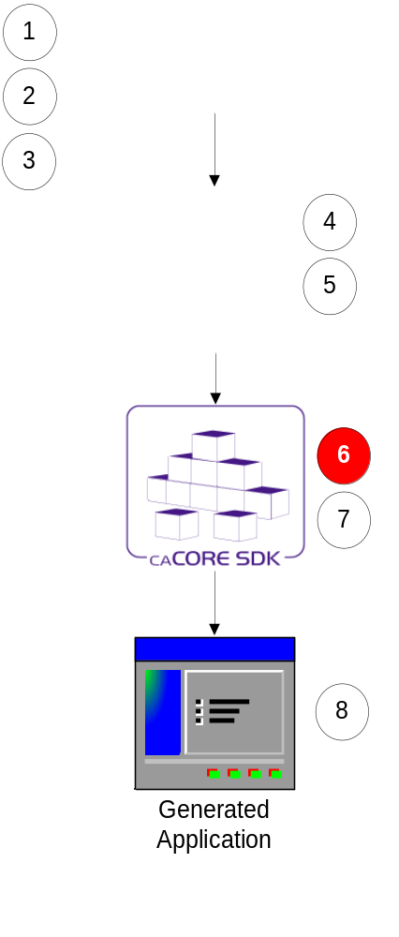
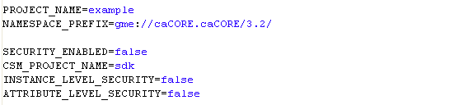
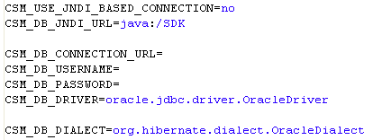
Step 6:
Configure Code Generator
Configuration defined in deploy.properties

Slide 21
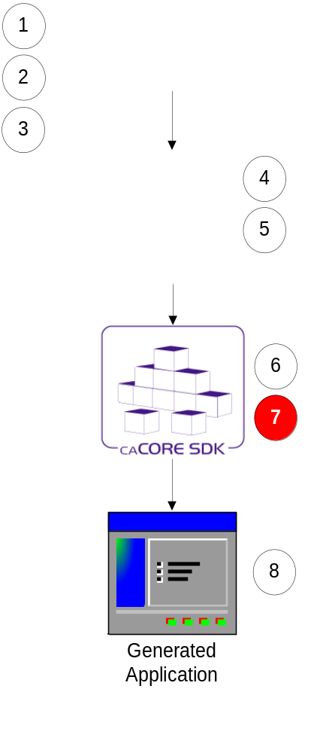
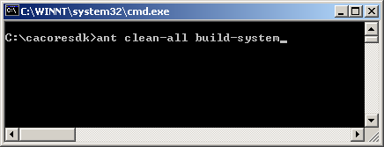
Step 7:
Run Code Generator
Put exported XMI file in caCORE SDK’s models directory
Go to command window
Execute build-system target

Slide 22
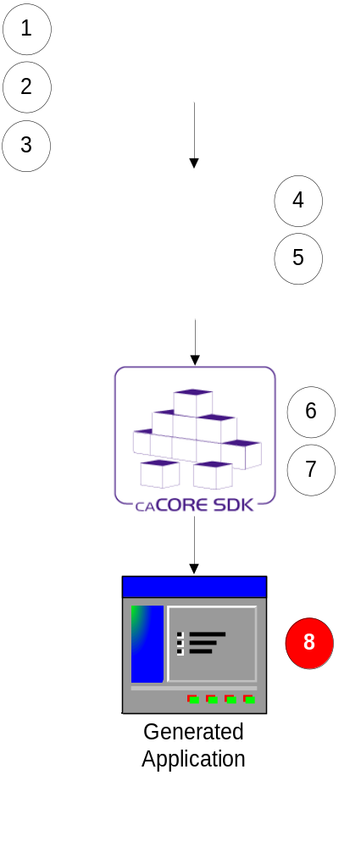
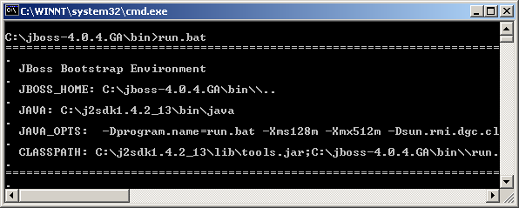
Step 8:
Running Generated System
Start application server

Slide 23
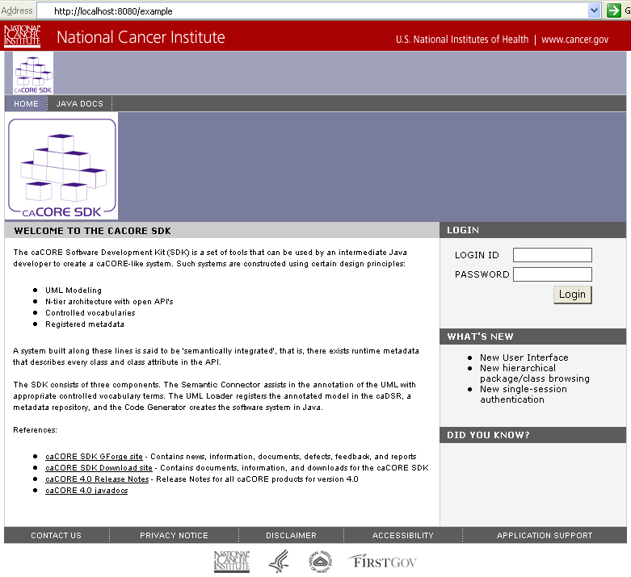
SDK Generated System – HTTP Interface

Slide 24
SDK Generated System – XML Interface
URLConnection conn = url.openConnection(); String base64 = "userId" + ":" + "password"; conn.setRequestProperty("Authorization", "Basic " + new String( org.apache.commons.codec.binary.Base64.encodeBase64( base64.getBytes())));

Slide 25
SDK Generated System –
Web Service Interface
SOAPHeaderElement headerElement = new SOAPHeaderElement( call.getOperationName().getNamespaceURI(),"SecurityHeader"); headerElement.setPrefix("security"); headerElement.setMustUnderstand(false); SOAPElement usernameElement = headerElement.addChildElement("username"); usernameElement.addTextNode("userId"); SOAPElement passwordElement = headerElement.addChildElement("password"); passwordElement.addTextNode("password"); call.addHeader(headerElement);

Slide 26
SDK Generated System – Java API
ApplicationService appService = ApplicationServiceProvider.getApplicationService(“username”, “password”);

Slide 27
Questions ???
SDK Users Mailing List
cacore_sdk_users-L@list.nih.gov

